Slide 1


Tunneling Phenomena in Ultra-Thin Oxide MOS Structures
Neelanjan Goswami
400414867
McMaster UNIVERSITY
Faculty Advisor:
Dr. Yaser Haddara
Department of Electrical and Computer Engineering
McMaster University

Slide 2
Contents
Introduction
Direct Tunneling
Fowler-Nordheim Tunneling
Modeling Assumptions - Direct Tunneling
Modeling Assumptions: Fowler - Nordheim Tunneling
Quantum Mechanical Calculations
Density-Gradient Approximation
Transmission Coefficient Approach
Dependence of Current
Formulation Of The Numerical Model
Numerical Results
Circuit Simulations
Influence of Oxide Thickness
Quantization of energy in levels: Accumulation and Inversion
Components of tunneling currents
Current Distribution in MOSFET Channels
Semiconductor Gate Layer Depletion
Potential Barrier Lowering Through Image Forces
Compact MOS Models: Understanding and Analyzing Gate Current
Consequences of Gate Tunneling Current on Device Performance
Conclusion
References

Slide 3
Introduction
Semiconductor devices have transformed electronics and opened up new opportunities for growth in several sectors, including computing, telecommunications, energy, and healthcare. They are a crucial component of numerous devices that are necessary for modern living.
MOS structures have attracted a lot of interest in the electronics industry because of its special qualities, which include high electron mobility and low power consumption. In the contemporary digital era, when there is an increasing need for small and power-efficient electronic equipment, they are especially pertinent.
This talk aims to give a thorough understanding of the tunneling phenomenon in ultra-thin oxide MOS systems. Understanding this quantum mechanical phenomenon is essential for the further advancement of electronic devices, since it can have a substantial impact on the performance of MOS structures.

Slide 4
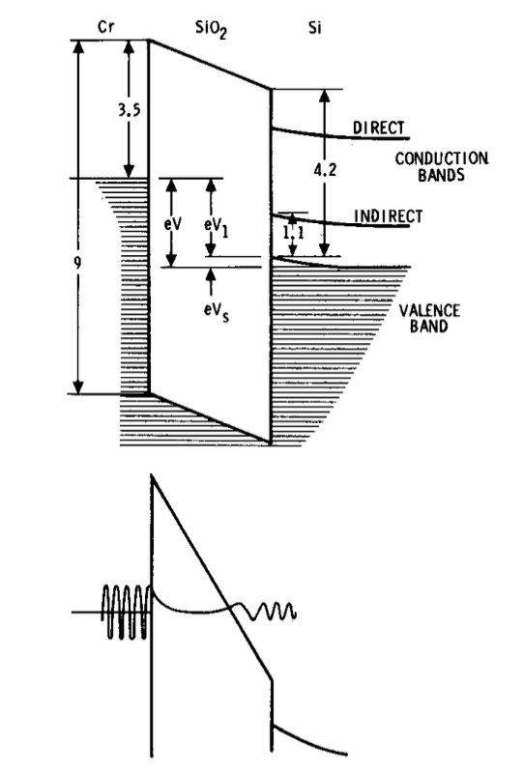
Introduction
Figure 1. A thin MOS structure band model. The Fowler-Nordheim tunneling is depicted in the lower diagram. [2]

Slide 5
Introduction
Si MOSFET prototypes with gate lengths significantly less than 20 nm are the product of ongoing advancements in Si nanotechnology. The importance of quantum processes like size quantization and gate oxide tunneling increases with decreasing channel lengths.
Conventional CMOS transistors reach their limits when dimensions and operating voltages decrease, propelling ongoing technological progress. Modern CMOS technology emphasizes how crucial gate oxide layer thickness: 1.2 - 1.5nm for channel lengths shorter than 100 nm.
A thorough grasp of contemporary semiconductor technologies is crucial because gate leakage current, particularly through edge direct tunneling (EDT), greatly affects off-state leakage and stability in Very Large Scale Integration (VLSI) circuits in ultra thin gate oxide domains.

Slide 6
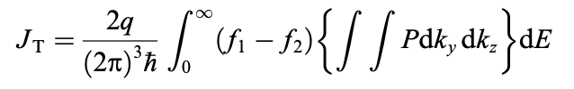
Direct Tunneling
In early MOS structures, tunneling currents were observed under high applied fields, causing a reduction in one side of the potential barrier at the SiO2 interface. Thick oxides (approx. 70–1000 Å) were used, making direct tunneling into the other electrode's conduction band improbable.
However, when oxide thickness is reduced to a few nanometers, direct tunneling at lower fields becomes significant, resulting in an approximately trapezoidal barrier (Fig. 3(b)).
The tunneling probability involves integration over wave vectors, electron energy, and probabilities of states on each side of the barrier. The Fermi–Dirac distribution functions and the effective mass approximation are essential in formulating the current-voltage relationship:
l
Notes:
where P is the tunneling probability, E is the total electron energy, ky and kz are the wave vectors in the plane of the barrier (perpendicular to the tunneling direction), and f1 and f2 are the probabilities of occupation of the states on each side of the barrier, given by the Fermi–Dirac distribution functions; the integration limits for ky and kz are determined from momentum and energy conservation.

Slide 7
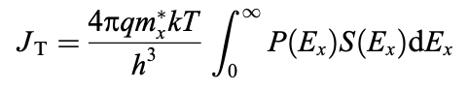
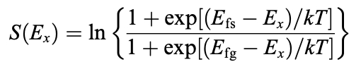
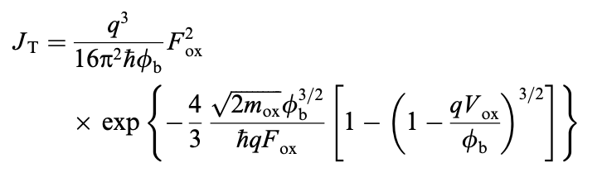
Direct Tunneling
Assuming that a single effective mass can be used for the electron in all three regions and integrating the Fermi–Dirac distribution function yields:
,where:
Determining tunneling current involves solving Schroedinger's equation for electron wave function, considering periodic lattice potential and applying approximations like the Wentzel–Kramers–Brillouin or neglecting Fermi–Dirac functions for modeling, with an alternative expression to address limitations:
Notes:
where h is Planck’s constant, mx is the electron effective mass in the direction perpendicular to the barrier, Ex is the electron kinetic energy in the direction perpendicular to the barrier, k is the Boltzmann constant, T is the temper- ature, and S(Ex) is the ‘‘supply’’ function, which is derived from the integration of the Fermi–Dirac distribution func- tion, and is given by [3]:
where Efs and Efg are the electron Fermi levels in the semi-
conductor and the gate, respectively. Note that the applied voltage is implicitly present in this equation through the difference between the Fermi levels. Finding the probability of tunneling through the barrier and solving the integral then becomes the only task left to determine the tunneling current. Schroedinger's equation for the electron wave function must be solved to get the tunneling probability. assuming the electron is free and including the effect of the periodic lattice potential through the use of the effective mass. f the potential is not constant, but it changes ‘‘slowly’’ with position, This is known as the Wentzel–Kramers–Brillouin (WKB) approximation. The condition of a ‘‘slow’’ change of the potential means that the changes in the potential and its derivative on each electron wavelength, should be small compared to the energy of the particle. Another possible approximation is to neglect the effect of the finite availability of carriers for tunneling, given in (3) by the presence of the Fermi–Dirac functions, by assuming a degenerate inversion or accumulation layer in the semiconductor surface This can be used to model the tunneling current for moderate applied bias, where there is strong inversion or accumulation, but the field is not high enough to cause Fowler–Nordheim tunneling. However, for low voltages, where there is a limited availability of carriers for tunnel- ing, this expression can overestimate the tunneling current by several orders of magnitude as shown in Fig. 8; besides, in (13) the current does not go to zero for zero field, which is to be expected from basic physics. An alternative expres- sion that overcomes this problem is [30]

Slide 8
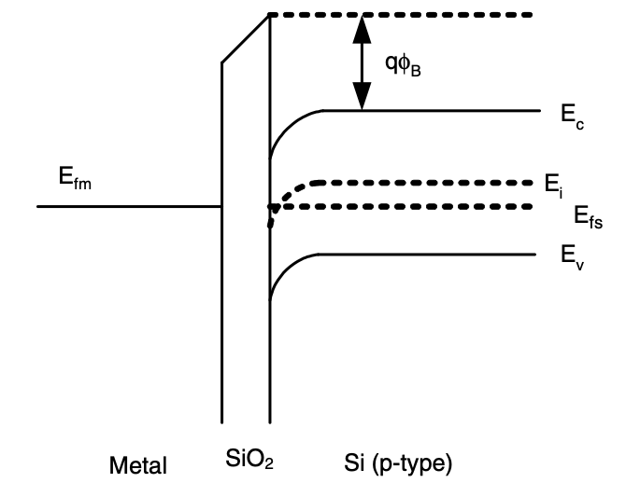
Fowler-Nordheim Tunneling
Figure 2. Band diagram for a structure consisting of metal, oxide, and semiconductor without any applied voltage; the oxide fixed charges and the difference in the work function of the metal and semiconductor create the band bending. The conduction band is denoted by Ec, intrinsic Fermi level by Ei, semiconductor Fermi level by Efs, and metal Fermi level by Efm. [1]

Slide 9
Fowler-Nordheim Tunneling
When a substantial positive voltage is applied to the metal compared to the substrate, the left side of the band diagram lowers. This voltage shift facilitates electron tunneling from the semiconductor's conduction band into the oxide's conduction band, forming an approximately triangular barrier.
The described tunneling through an approximately triangular potential barrier is identified as Fowler–Nordheim tunneling. This phenomenon occurs when a large positive voltage is applied, allowing electrons to tunnel through the triangular barrier. The simplicity of this tunneling process is captured in a relatively straightforward expression for current as a function of applied voltage.

Slide 10
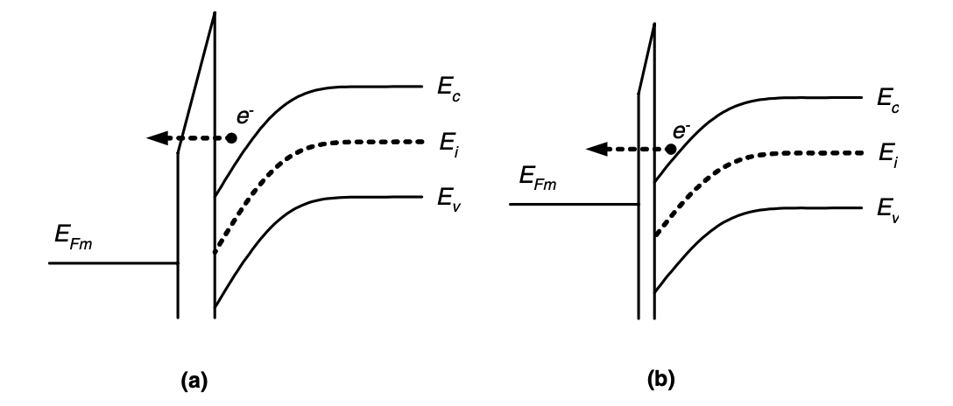
Fowler-Nordheim Tunneling
Figure 3. (a) Tunneling through a triangular barrier into the insulator conduction band (Fowler–Nordheim tunneling). (b) Tunneling through a trapezoidal barrier (direct tunneling). [1]

Slide 11
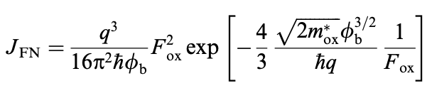
Fowler-Nordheim Tunneling
The band diagram's left-hand side lowering, induced by a large positive voltage on the metal, signifies a key aspect of the MOS device's operation. The voltage-induced shift in the band diagram enables the creation of the triangular barrier, facilitating electron tunneling from semiconductor to oxide. This process plays a crucial role in the device's functionality and is fundamental to understanding gate tunneling current in MOS devices.
This provides a relatively simple expression detailing the current as a function of applied voltage during Fowler–Nordheim tunneling:
Understanding this current-voltage relationship is vital for comprehending the gate tunneling current in MOS devices, offering insights into their electrical behavior.
Notes:
where q is the electron charge, h is Planck’s reduced con- stant, mox is the electron effective mass in the insulator, /b is the barrier height at the semiconductor–oxide inter- face and Fox is the electric field across the oxide. The assumptions for the derivation of (1) are [8,9]:
The electrons on the emitting electrode can be described as a free Fermi gas.
The dependence of carrier availability for tunneling with respect to temperature is not taken into account.
The potential barrier has triangular shape and barrier lowering due to image forces is neglected.
The effect of the insulator can be described by a single effective mass.
The tunneling probability takes into account only the component of the electron momentum in the direction normal to the surface.

Slide 12
Modeling Assumptions - Direct Tunneling
Direct tunneling is a fascinating quantum mechanical process where electrons can tunnel through a classically forbidden energy state.
Free Fermi Gas: In direct tunneling, electrons on the emitting electrode are treated as a free Fermi gas, adhering to the Pauli Exclusion Principle and occupying distinct quantum states without interaction.
Temperature Dependence: Interestingly, in the modeling of direct tunneling, the dependence of carrier availability for tunneling with respect to temperature is not considered. This is because the tunneling process is primarily determined by the properties of the barrier (such as its height and width) and the energy of the electrons, rather than the thermal energy of the system.
Potential Barrier: In direct tunneling, the assumed triangular potential barrier simplifies mathematical analysis, though real barriers may have a more complex shape. Neglecting image forces in modeling is common; these forces, arising from an electron's interaction with its image charge, can lower the barrier but are often considered negligible.

Slide 13
Modeling Assumptions: Fowler - Nordheim Tunneling
Fowler-Nordheim tunneling, a special case of direct tunneling, occurs in a high electric field in a metal-oxide-semiconductor (MOS) structure, leading to a thinning of the barrier at the metal-oxide interface and facilitating electron tunneling.
Wave-Mechanical Tunneling: In Fowler-Nordheim tunneling, electrons wave-mechanically tunnel through a rounded triangular barrier formed at the surface of an electron conductor under a high electric field, with the barrier shape influenced by material properties and field strength.
Escape of Electrons: Individual electrons can escape by Fowler-Nordheim tunneling from many materials in various different circumstances. This is because the probability of tunneling depends on the properties of the materials and the strength of the electric field, rather than the specific details of the system. As a result, Fowler-Nordheim tunneling can occur in a wide range of systems, from microelectronic devices to astrophysical objects.

Slide 14
Quantum Mechanical Calculations
Quantum mechanical calculations, considering the wave-like nature of particles, are crucial for comprehending and predicting nanoscale phenomena, including electron behavior in direct tunneling.
Silicon Substrate: In the context of direct tunneling, these quantum mechanical calculations are applied to the silicon substrate. The silicon substrate is the part of the device where the electrons originate from and return to during the tunneling process. By applying quantum mechanical calculations to the silicon substrate, we can predict how the electrons will behave when they encounter the potential barrier.
Tsu-Esaki Formula: A common approach to model the tunneling current is the Tsu-Esaki formula. This formula, named after Raphael Tsu and Leo Esaki, who first derived it, describes the current density of a tunnel junction as a function of the applied voltage. The Tsu-Esaki formula is based on the assumption that the tunneling process is coherent, meaning that the phase of the electron wavefunction is preserved as the electron tunnels through the barrier.
Transmission Coefficient and Supply Function: In direct tunneling calculations, the transmission coefficient signifies the likelihood of electron tunneling through the barrier, while the supply function characterizes the electron availability for tunneling. The prediction of tunneling current in a device relies on calculating these parameters, where the transmission coefficient is influenced by barrier properties and electron energy, and the supply function depends on silicon substrate properties and applied voltage.

Slide 15
Density-Gradient Approximation
The density-gradient approximation is a method used in quantum transport theory. It’s particularly useful for analyzing tunneling phenomena in ultra-thin oxide Metal-Oxide-Semiconductor (MOS) structures. Here are some key points:
Application: The density-gradient approximation is applied to analyze the behavior of electrons and holes in ultra-thin oxide MOS structures. These structures are common in modern semiconductor devices.
Quantum Transport Theory: This theory describes how particles such as electrons move at the quantum level. The density-gradient approximation is used within this theory to understand various effects.
Effects Analyzed: Several effects can be understood using this approximation, including:
Direct Tunneling: This is a quantum mechanical effect where particles move through a barrier instead of over it.
Polysilicon Depletion: This refers to the reduction of mobile charge carriers in polysilicon, affecting the electrical properties of the material.
Hole Tunneling: This is the movement of positive charge carriers (holes) through a barrier.
Valence Band Tunneling: This is the tunneling of electrons from the valence band of one material to the conduction band of another.
Advantages: The density-gradient approach provides a physics-based method that works well in all bias regimes. This makes it a versatile tool for analyzing a wide range of semiconductor devices. Moreover, its simplicity makes it suitable for engineering applications, where ease of use and computational efficiency are important.
Notes:
Quantum Transport Theory (QTT) is a branch of physics that describes how particles, such as electrons, move at the quantum level. It’s a fundamental aspect of quantum mechanics and is particularly important in the field of condensed matter physics¹².
The theory is concerned with the movement of particles in a quantum system, taking into account the principles of quantum mechanics such as wave-particle duality and superposition¹². It provides a framework for understanding how particles behave when they are part of a quantum system, and how they interact with their environment².
The Density-Gradient Approximation is a method used within Quantum Transport Theory. It’s a simplification used to make the complex calculations of quantum mechanics more manageable. This approximation is particularly useful in understanding various effects in quantum systems¹².
Here are some of the effects that can be understood using this approximation:
Direct Tunneling: This is a quantum mechanical effect where particles move through a barrier instead of over it. This is a direct result of the wave-like nature of particles in quantum mechanics.
Polysilicon Depletion: This refers to the reduction of mobile charge carriers in polysilicon, affecting the electrical properties of the material. Understanding this effect is crucial in the design and operation of semiconductor devices.
Hole Tunneling: This is the movement of positive charge carriers (holes) through a barrier. This effect is important in p-type semiconductors.
Valence Band Tunneling: This is the tunneling of electrons from the valence band of one material to the conduction band of another. This effect is key in the operation of many electronic devices.
In summary, Quantum Transport Theory, with the help of the Density-Gradient Approximation, provides a powerful tool for understanding and predicting the behavior of particles in quantum systems¹².

Slide 16
Transmission Coefficient Approach
The transmission coefficient approach models quantum tunneling, like Fowler-Nordheim tunneling, by assessing the probability of particles passing through a potential barrier. In Fowler-Nordheim tunneling, the transmission coefficient is adjusted by the influence of the image force.
Image Force: The image force is a force experienced by an electron due to its interaction with its own image charge in a conducting material. This force can effectively lower the height of the barrier, making it easier for the electron to tunnel through. By considering the image force, the transmission coefficient approach provides a more accurate model of the tunneling process.
Thicker Dielectrics and High Electric Fields: The transmission coefficient approach is particularly significant for thicker dielectrics and sufficiently high electric fields. In these conditions, the image force can have a substantial effect on the tunneling process and neglecting it can lead to inaccurate predictions. By using the transmission coefficient approach, we can accurately model and predict the behavior of devices operating under these conditions.
Comparison with WKB Approximation: The transmission coefficient approach enhances tunneling modeling accuracy compared to the Wentzel–Kramers–Brillouin (WKB) approximation. WKB, effective in many cases, struggles with non-smooth barriers or near-barrier energy. The transmission coefficient approach, incorporating the image force, excels in accurately representing such scenarios, proving valuable for electronic device design based on tunneling phenomena.
Notes:
Comparison with WKB Approximation: The transmission coefficient approach provides a more accurate representation of the tunneling transmission coefficient compared to the Wentzel–Kramers–Brillouin (WKB) approximation. The WKB approximation is a method used in quantum mechanics to find approximate solutions to the Schrödinger equation. While the WKB approximation can provide a good estimate of the transmission coefficient in many cases, it can be less accurate when the potential barrier is not smooth or when the energy of the particle is close to the height of the barrier. In contrast, the transmission coefficient approach can accurately model these situations by taking into account the image force. This makes it a powerful tool for studying and designing electronic devices that operate based on the tunneling phenomenon.

Slide 17
Dependence of Current
The transmission coefficient approach models quantum tunneling, like Fowler-Nordheim tunneling, by assessing the probability of particles passing through a potential barrier. In Fowler-Nordheim tunneling, the transmission coefficient is adjusted by the influence of the image force.
On Bias: Increasing the gate voltage in a MOS structure enhances the electric field in the substrate, providing additional energy to carriers (e.g., electrons). The heightened energy increases the probability of carriers overcoming the potential barrier and tunneling through the oxide layer, resulting in an elevated tunneling current.
On Temperature: Temperature affects tunneling current differently at varying temperature ranges. Above approximately 348 K, gate current exponentially depends on the inverse of temperature (1/T) due to increased thermally excited carriers. Below ~348 K, gate current is weakly temperature-dependent, dominated by field-activated direct tunneling, where electric field influences current more than thermal energy.
On Materials: Material selection in MOS structures impacts tunneling current. The choice of gate dielectrics influences the potential barrier's height and width, critical for carrier tunneling. Varied dielectric constants and bandgap energies in different materials affect tunneling probability, offering control over the tunneling current by selecting appropriate materials.
On Dimensions: The oxide layer's thickness is pivotal in direct tunneling, as decreasing it reduces the potential barrier width, exponentially increasing tunneling probability and resulting in a corresponding exponential rise in direct tunneling current.
Notes:
Sure, let’s delve deeper into the dependence of current on bias, temperature, materials, and dimensions in ultra-thin oxide MOS structures:
On Bias: The gate voltage in a MOS structure controls the electric field in the substrate. When the gate voltage is increased, the electric field in the substrate also increases. This increased electric field gives more energy to the carriers (like electrons) in the substrate. With more energy, these carriers have a higher probability of overcoming the potential barrier and tunneling through the oxide layer. This is why the tunneling current increases with the gate voltage.
On Temperature: The temperature has a dual effect on the tunneling current. For temperatures above approximately 348 K (about 75 degrees Celsius), the gate current is exponentially dependent on the inverse of the temperature (1/T). This is because as the temperature increases, the number of thermally excited carriers that can overcome the barrier increases, leading to an increase in current. However, for temperatures below ~348 K, the gate current is weakly dependent on temperature and is dominated by field-activated direct tunneling. In this regime, the tunneling current is more influenced by the electric field than by the thermal energy of the carriers.
On Materials: The type of materials used in the MOS structure can influence the tunneling current. For instance, the type of gate dielectrics used can affect the height and width of the potential barrier that the carriers need to tunnel through. Different materials have different dielectric constants and bandgap energies, which can affect the tunneling probability. Therefore, by choosing appropriate materials, it is possible to control the tunneling current.
On Dimensions: The thickness of the oxide layer plays a crucial role in direct tunneling. As the oxide thickness decreases, the width of the potential barrier that the carriers need to tunnel through also decreases. According to the principles of quantum mechanics, the tunneling probability increases exponentially with decreasing barrier width. Therefore, as the oxide thickness decreases, the direct tunneling current increases exponentially.

Slide 18
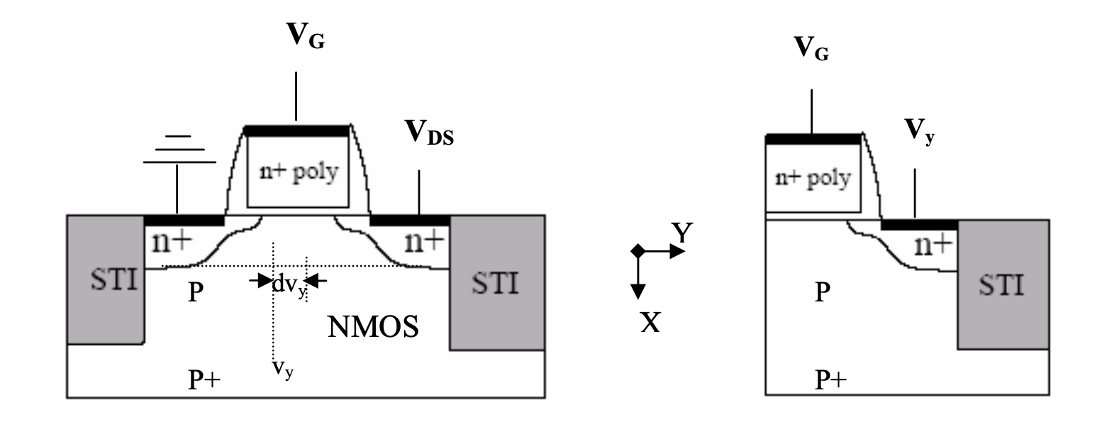
Formulation Of The Numerical Model
Figure 4: Cross-section of non-uniformly doped n-channel MOSFET. Cross-section of the controlled MOS structure corresponding the Quasi-equilibrium situation at the Conducting channel of the transistor [1]

Slide 19
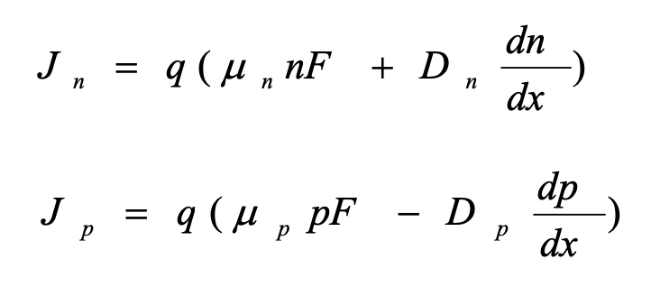
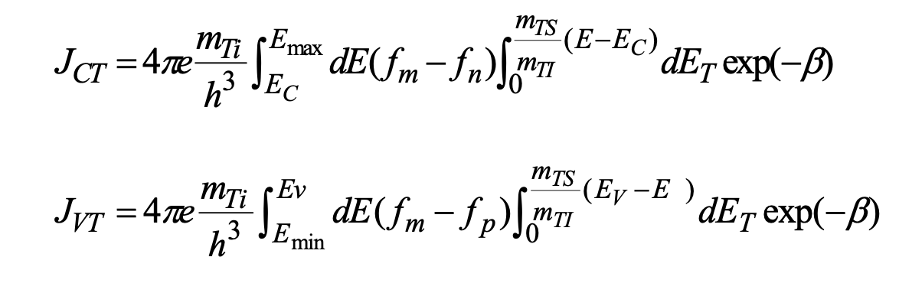
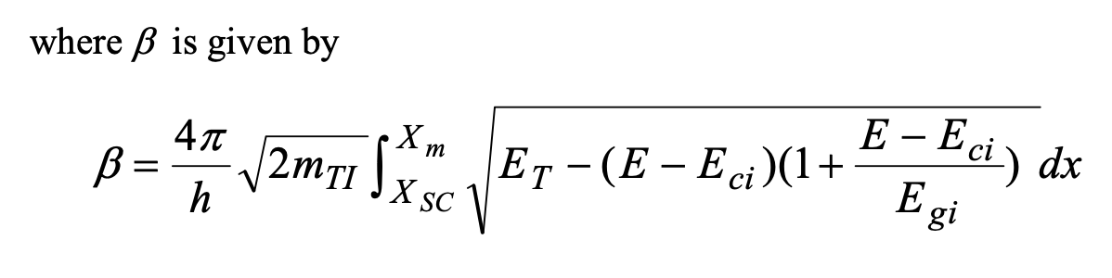
Formulation Of The Numerical Model
The MOSFET transistor, comprising a series of MIS controlled diodes along its channel, exhibits non-uniform doping in a one-dimensional x-direction. Quasi-Fermi levels vary with bias voltages (0 ≤ V_{Y} ≤ V_{DS}), and the device, with a non-uniformly doped substrate, is analyzed using a set of nonlinear equations numerically solved for MOSFET response, considering semiconductor transportation and gate-semiconductor tunneling interactions.
Current Transportation In The Semiconductor Region:
Characterization Of The Tunneling Through The Insulator:
Notes:
The semiconductor region of the MOSFET is characterized by the following set of differential equations [6 and 7]
(a) Poisson’s equation is given by:
−d2ψ=dF =q[p(x)−n(x)+N(x)] dx2 dx ε
(2)
Where ψ(x) resembles the electric potential within the semiconductor and F
denotes the built-in electric field at the position x and N (x ) is the non-uniform
impurity distribution at any distance x. Note that x begins at the insulator- semiconductor interface along the semiconductor.
(3)
(4)
E−E p(x)=niexp i Fp 
Fn i  n(x)=nexpE −E(x)
 KT  J =q(μnF+D dn)
 KT 
i (b) The current density equations are:
n n ndx
J = q(μ pF − D dp ) p p pdx
where μn and μp as a function of impurity concentration are given by (Zambuto,1989).
1330 −65 1+[ N(x) ]0.76
dn = G − U + 1 dJ n dt q dx
dp = G − U − 1 dJ p dt q dx
where U is the net thermal generation-recombination rate Shockley-Read-Hall equation:
μn =
μp = (c) The electrons and holes continuity equations are:
+65.5
8.5 ⋅ 10 16 495−47.7
+47.7
(5)
(6)
which is usually given by
1+[ N(x) ]0.72 6.3 ⋅ 10 16
where τn and τp 1997)
pn − n2 i
6 (7)
U= as a function of impurity concentration are given by (Weber et al.,
(8)
τn(n+n1)+τp(p+ p1)
τ no 1+N(x)
τn= N ref
τ po 1+N(x)
τp= N ref
where Nref =2⋅1016 cm-3 , τno and τpo are the minority carrier lifetime for electrons and holes at lightly doped semiconductor and G is the number of electron-hole pairs (EHPs) generated per unite volume at a distance x from the insulator-semiconductor . According to the energy band diagram shown in Fig.5 there are net current JCT and JVT
flowing from the conduction and from the valence bands of the semiconductor to the gate contact. The tunneling current JCT and JVT can be evaluated using the independent electron approach outlined by Harison [8] for (100)-oriented silicon and, employing the expression given by Green and et al [9].
where β is given by
mE mTS(E−E)
J =4πe dE(f−f)mTI dEexp(−β) CT Ti∫max m n∫ C T
h3 EC 0 m Ev mTS(E−E)
(9) J =4πe dE(f−f)mTI dEexp(−β)
VT Ti∫mp∫V T h3 Emin 0
4πX E−E β = 2mTI ∫ m ET − (E − Eci )(1+ ci ) dx
h XSC Egi
(10)

Slide 20
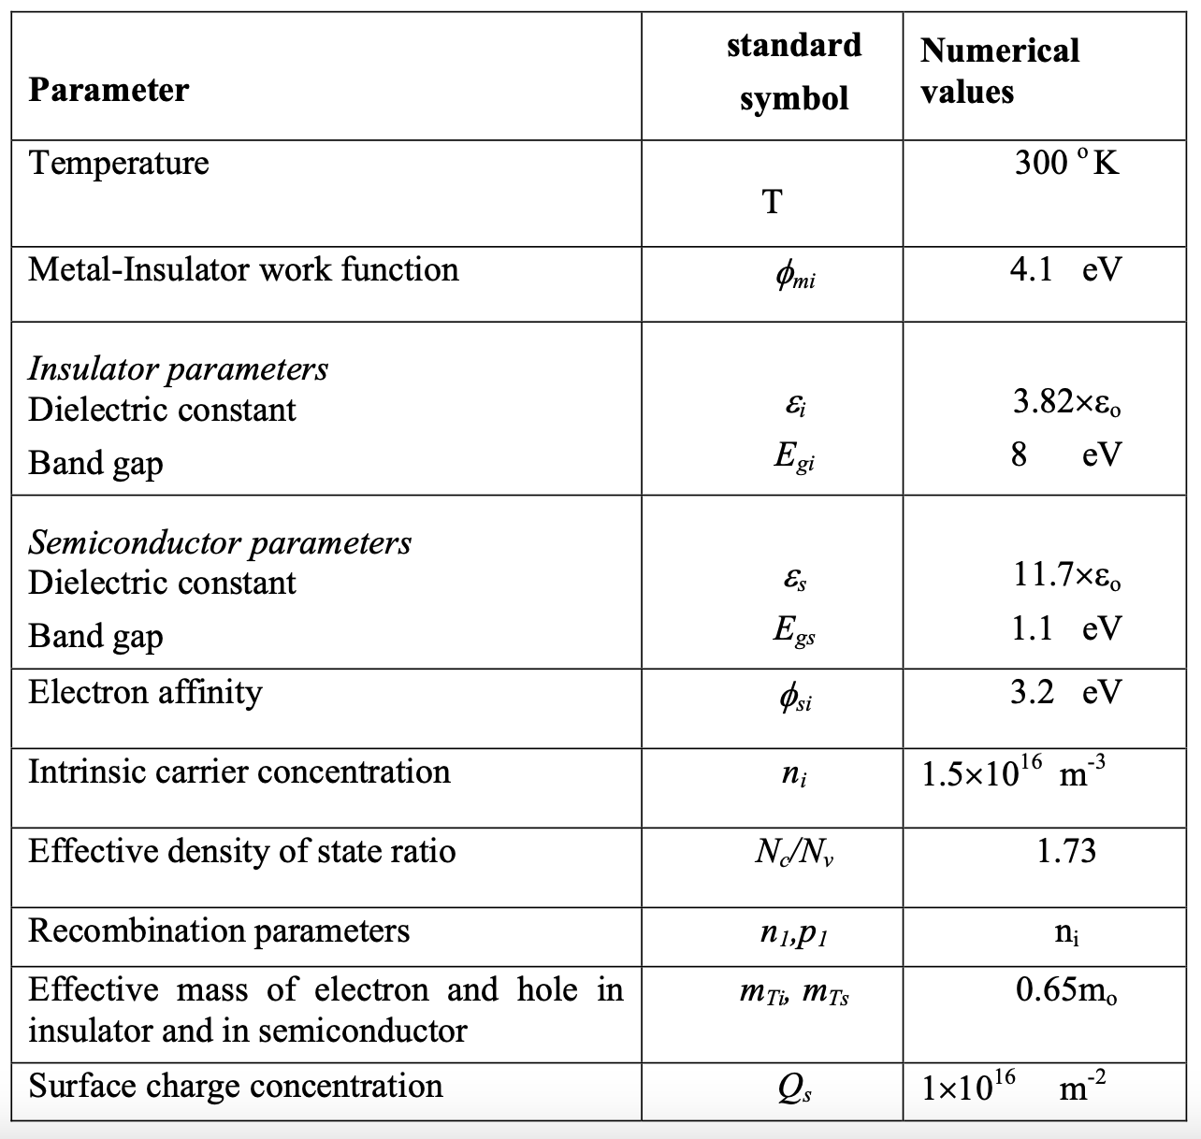
Numerical Results
Table 1: The basic input parameters for MOSFET device

Slide 21
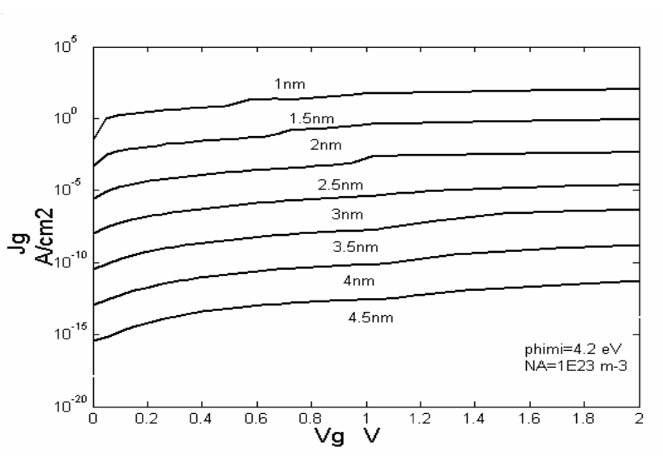
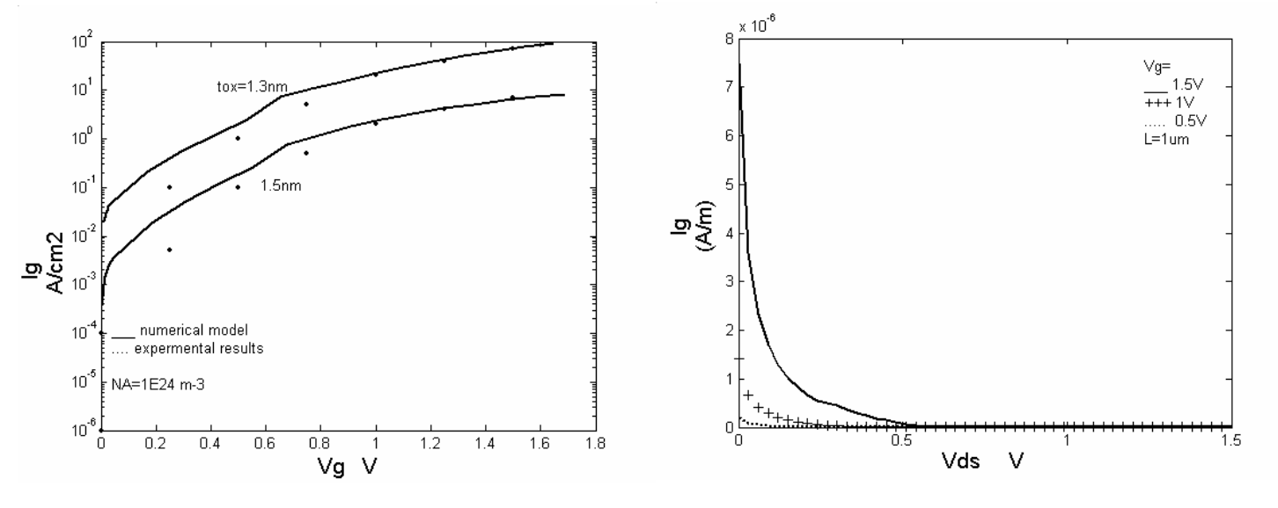
Numerical Results
Figure 6: Tunneling current as function of V_{G} at different values of t_{ox}. [4]
Figure 7: tunneling current as function of V_{DS} [4]
Figure 5: Tunneling current as function of V_{G} at different values of t_{ox} [4]

Slide 22
Numerical Results
Though the calculations are generally applicable for any other semiconductor materials for the substrate and any other materials for the gate contact, the numerical results are limited to P-type silicon substrate MOSFET (n-channel) with a polysilicon for the gate contact. Table 1 presents a list of the numerical values corresponding to the model parameters.
Oxide Thickness's Impact On The Gate Current
As illustrated in Figure 5, a decrease in oxide thickness will result in a rise in gate current because it increases the likelihood that carriers will tunnel through the gate insulator, which in turn increases the tunneling current. As an example, Figure 6 illustrates the gate current as a function of gate voltage at various oxide thicknesses, allowing one to compare the numerical result with accurate observations.
The numerical model's generated gate currents for oxide thicknesses of 1.5 and 1.3 nm show good agreement with measurement values. The surface roughness, the uncertainty surrounding the effective oxide thickness, and the voltage drop at the poly-gate resulting from the gate leakage current are likely the causes of the discrepancies between the simulated and observed data in Figure 6.

Slide 23
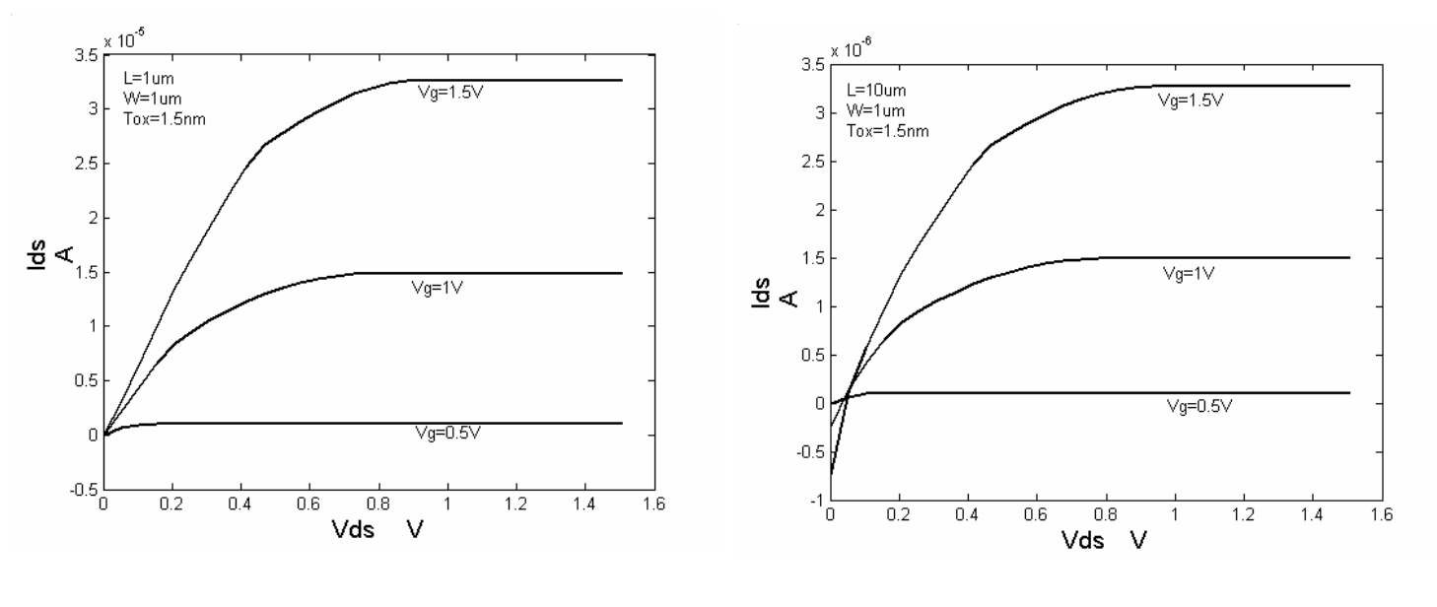
Numerical Results
Figure 8: the drain current as function of VDS for different channel length (a)L=1 μm (b) L=10 μm . [4]

Slide 24
Numerical Results
Drain Voltage's Impact On Gate Current
As seen in Fig. 7, the gate tunneling current is computed as a function of drain voltage for various gate voltage levels to account for the impact of drain voltage on the current. Because of the increased surface potential at the drain, which lowers the voltage across the insulator, the simulated gate current drops as the drain bias increases.
When the potential of the drain is larger than the gate's, the direction of gate current near the drain region may even reverse. The gate current impact is predominant at high VGS & low VDS bias circumstances. As a result, the total gate tunneling current decreases as the drain bias shifts from the linear to saturation region operation.
Tunneling Current's Impact On Drain Current
Fig. 8(a) and (b) illustrate how the gate tunneling current affects the drain current for various channel lengths.Since the channel current is significantly higher than the gate current and the gate current drops with decreasing channel length, it is evident that the effect of the gate tunneling current on the drain current becomes less problematic for the short channel MOSFETs.
The total gate currents for the entire chip will pose a severe issue for applications requiring battery operation, even though the gate currents for a single transistor might not seem like much.

Slide 25
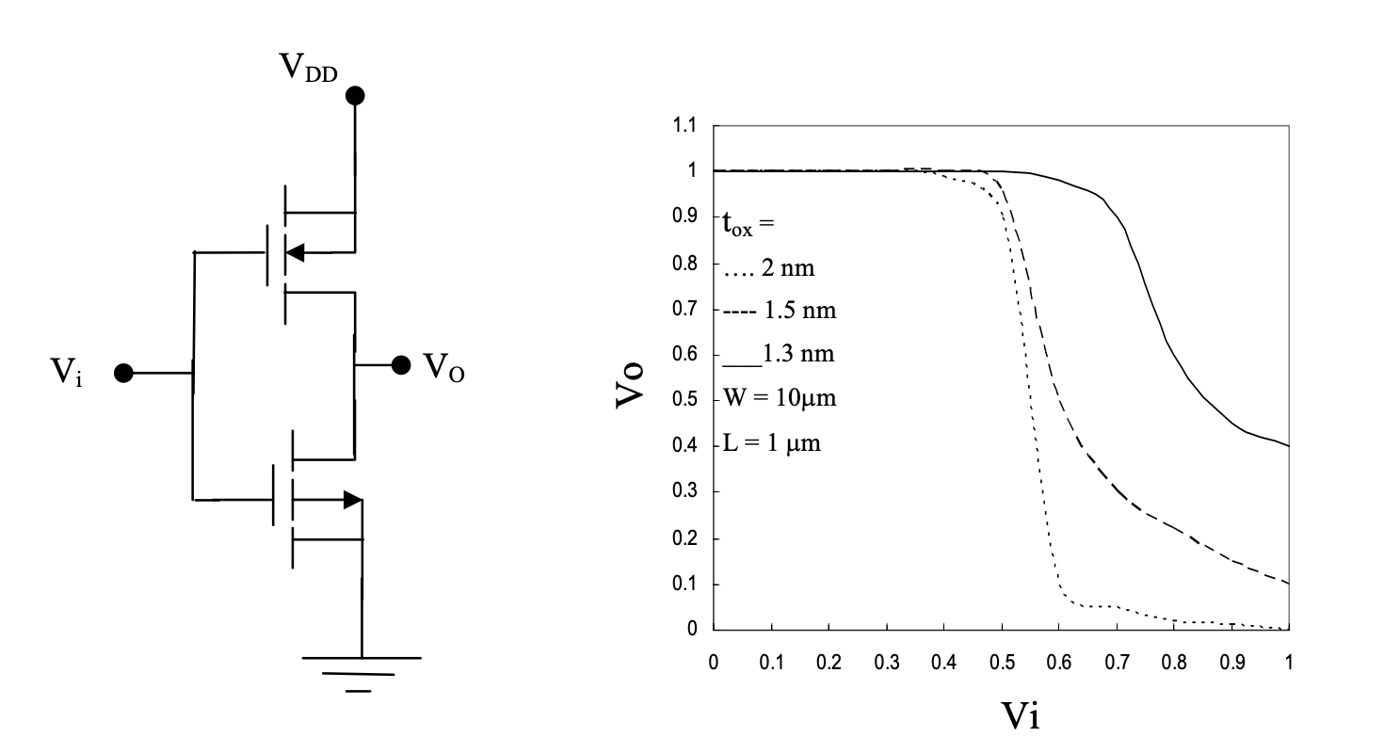
Circuit Simulations
Figure 9: Schematic of CMOS inverter. Fig.10: Transfer characteristics of CMOS Inverter for gate oxide thinner than 2nm [4]

Slide 26
Circuit Simulations
Data Utilization: The numerical data obtained from the experiments are used to simulate the effect of gate current on the transfer characteristics of the CMOS inverter, as shown in Fig.9.
Simulation Results: The results of these simulations are depicted in Fig.10. They demonstrate the impact of scaling down the oxide thickness to less than 2nm.
Implications: Reducing the oxide thickness to below 2nm leads to a significant increase in the output low-level voltage. This increase worsens the noise margin and can result in faulty operation for the CMOS inverter.

Slide 27
Influence of Oxide Thickness
Oxide Thickness Determination: The study utilized ellipsometry and C-V measurements for determining the oxide thickness. Ellipsometry provided an initial guide, while C-V measurements offered a more accurate thickness by accounting for the accumulation layer in silicon. The study employed an MOS array with CrAu metallization and patterning, considering film reduction due to metallization.
Capacitance Analysis: The analysis of capacitance showed that for a 40 A oxide film, the capacitance did not saturate at the oxide capacitance Cox even at high fields corresponding to degenerate accumulation. The study introduced a convenient expression involving surface capacitance C to provide insights into the contribution of the accumulation layer in silicon.
Tunneling Current and Capacitance Correlation: The research identified a smooth correlation between the measured tunneling current and capacitance across adjacent MOS squares. The log of the tunneling current was found to be nearly proportional to the oxide thickness. This finding underscores the uniformity or slight regular variation in the oxide film, indicating high overall uniformity.

Slide 28
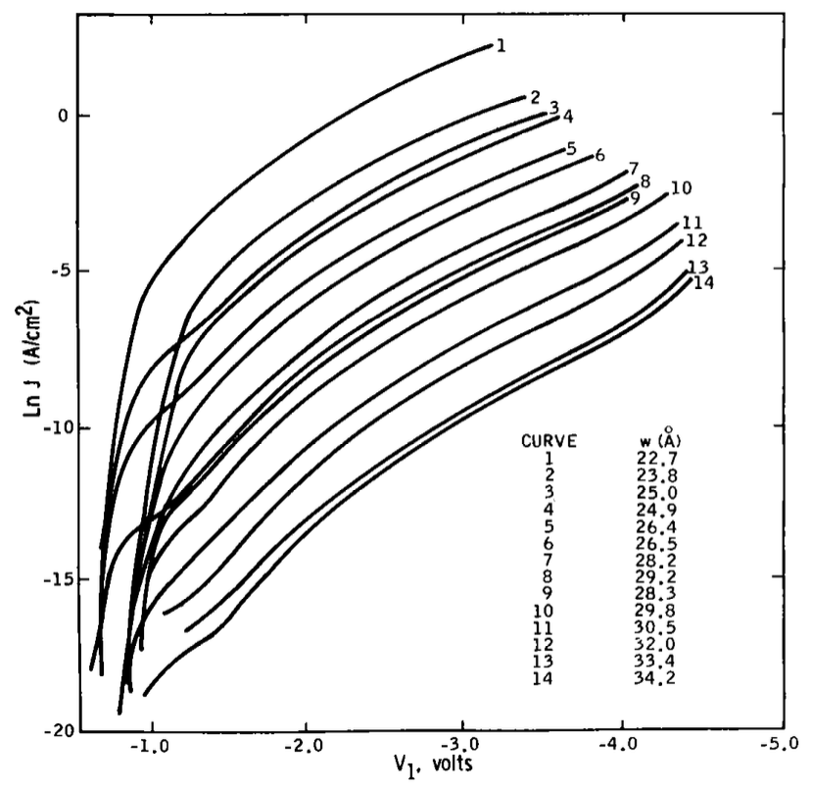
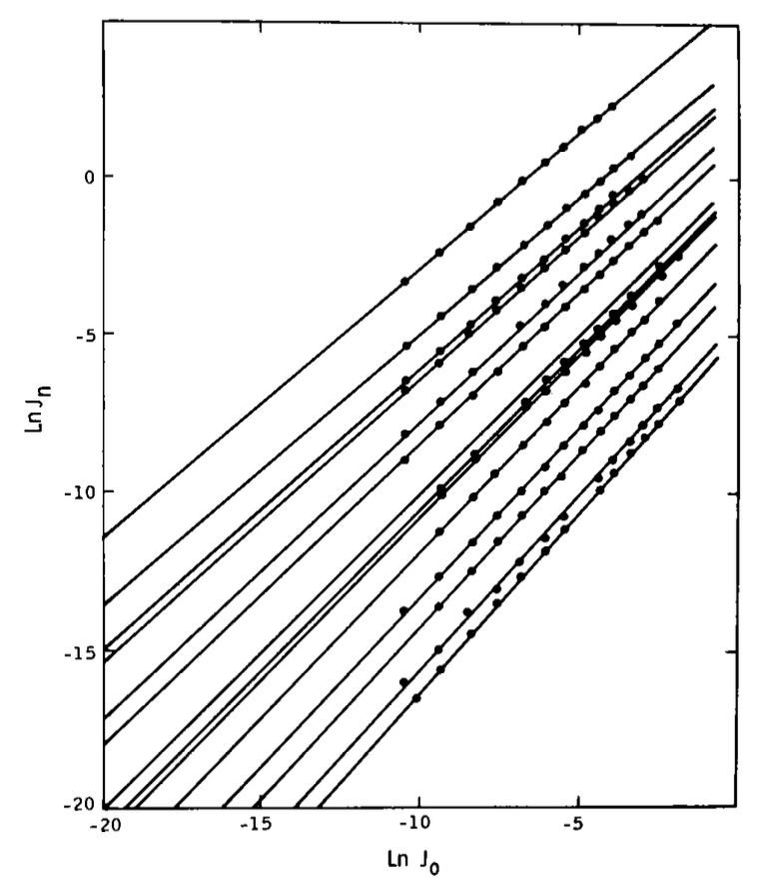
Influence of Oxide Thickness
Figure 10: Tunneling characteristics at various oxide thicknesses – Two wafers with various surface treatments yielded varied results. Tunneling current interdependency throughout oxide thicknesses. [2]

Slide 29
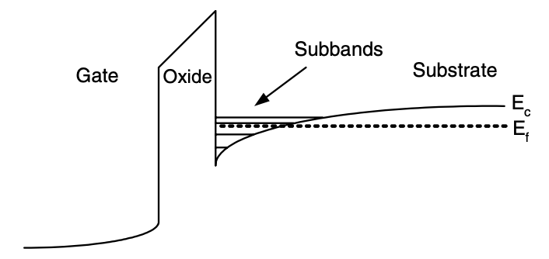
Quantization of energy in levels: Accumulation and Inversion
Figure 11. Diagrammatic band profile for a poly Si–SiO2–Si structure in inversion, demonstrating how carrier confinement in a limited potential well causes the creation of sub-bands. [1]

Slide 30
Quantization of energy in levels: Accumulation and Inversion
FN Formula Limitations: The Fowler-Nordheim (FN) formula, which assumes a three-dimensional free Fermi gas model, encounters inaccuracies in semiconductor capacitance estimation due to electric field-induced band bending. This leads to the formation of a two-dimensional electron gas (2-DEG) with quantization effects that alter the carrier concentration distribution and affect capacitance predictions.
Quantized Electron Energies: The quantized electron energies in accumulation/inversion layers necessitate a departure from the free electron gas model. Gate tunneling current calculations incorporate a ‘carrier tunneling lifetime’ for electrons in quantized energy levels. This is determined through the simultaneous solution of Schrödinger’s equation, providing insights into their behavior in the potential well.
Barrier Lowering Considerations: Gate tunneling current calculations require considering image-force-induced barrier lowering, especially for very thin oxides. This challenges the conventional neglect of this factor and emphasizes the necessity of accurate modeling for tunneling current predictions.

Slide 31
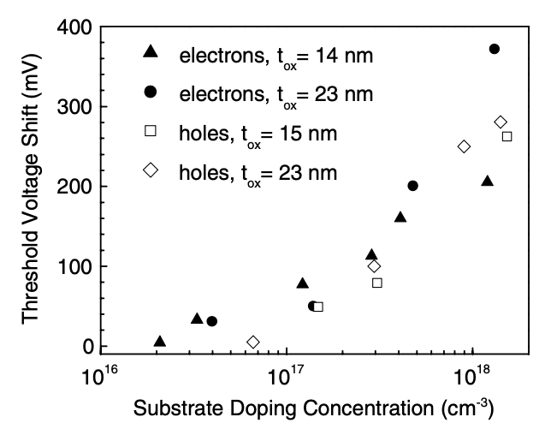
Quantization of energy in levels: Accumulation and Inversion
Figure 12. Variation in the threshold voltage for electron and hole inversion layers due to quantum-mechanical processes in the substrate as compared to the classical theory [1]

Slide 32
Quantization of energy in levels: Accumulation and Inversion
Quantization Effects in Substrate: Quantization effects, particularly pronounced in highly doped semiconductor substrates, lead to a significant increase in the threshold voltage of MOS transistors. This underscores the critical role of quantum effects in transistor performance.
Quantized Electron Energies: The quantization of electron energies in accumulation/inversion layers necessitates the use of a ‘carrier tunneling lifetime’ instead of a ‘transmission probability’ for tunneling current calculations. This involves solving Schrödinger’s and Poisson’s equations simultaneously to determine the lifetimes of quasi-bound states and understand the behavior of electrons influenced by the potential barrier.
Impact on Threshold Voltage: The quantization effects in semiconductor substrates have a significant impact on the threshold voltage of MOS transistors. This emphasizes the need to depart from the free electron gas model, use a ‘carrier tunneling lifetime’ for calculating the tunneling current, and consider quasi-bound states when solving Schrödinger’s and Poisson’s equations.

Slide 33
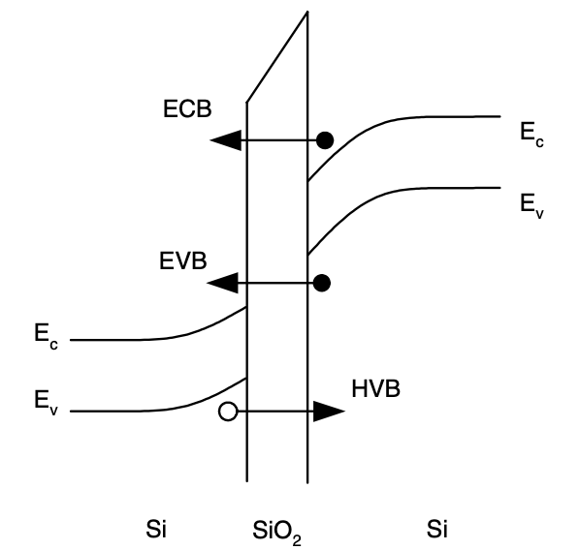
Components of tunneling currents
Figure 13: Diagrammatic illustration of the tunneling elements in a Si/ SiO2/Si structure. [1]

Slide 34
Components of tunneling currents
Besides conventional ECB electron tunneling, other mechanisms include EVB (valence to conduction) and HVB (hole to valence) tunneling, where HVB tunneling is akin to electron tunneling within the valence band, contrasting with EVB tunneling.
In short-channel devices, Edge Direct Tunneling (EDT) becomes crucial, surpassing other leakage mechanisms like gate-induced drain leakage (GIDL) and band-to-band tunneling (BTBT) for ultra-thin gate oxides, as highlighted in Fig. 14, emphasizing overlap currents' dominance, including EDT, despite a much larger channel area than the overlap area.
Distinct tunneling mechanisms dominate current components in different operating regions. For nMOS in inversion, gate-to-channel current (Igc) is primarily ECB, while gate–bulk current (Igb) is caused by EVB at high voltages. Tunneling probabilities, influenced by factors like barrier height and carrier availability, vary across ECB, EVB, and HVB for nMOS and pMOS as in Table 1.

Slide 35
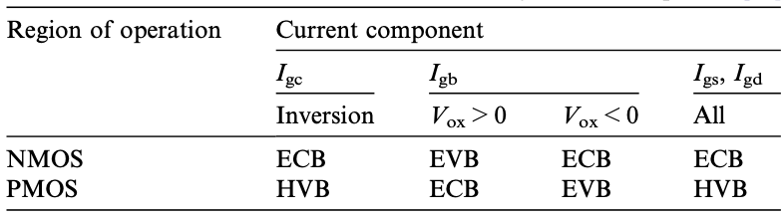
Components of tunneling currents
Table 2: Dominant current mechanisms for every component of the tunneling current. [1]

Slide 36
Components of tunneling currents
Gate Tunneling Current Calculations: These calculations involve expressing each quantized energy level’s contribution using a “carrier tunneling lifetime”. This is determined through self-consistent solutions of Schrödinger’s and Poisson’s equations. Numerical methods that address carrier quantization effects are commonly used in compact modeling.
Position-Dependent Tunneling Current Density: In MOS transistors, understanding the position-dependent tunneling current density along the channel is crucial for optimizing device performance. This is influenced by factors such as the polysilicon gate and its depletion effects.
Determining Critical Tunneling Lifetime: The critical tunneling lifetime for gate current modeling can be determined via semi-classical or fully quantum-mechanical methods. These treat quasi-bound states as bouncing particles or consider well/barrier scattering centers. The transverse-resonant method, a numerical approach, calculates the resonance width, offering insights into energy broadening during tunneling.

Slide 37
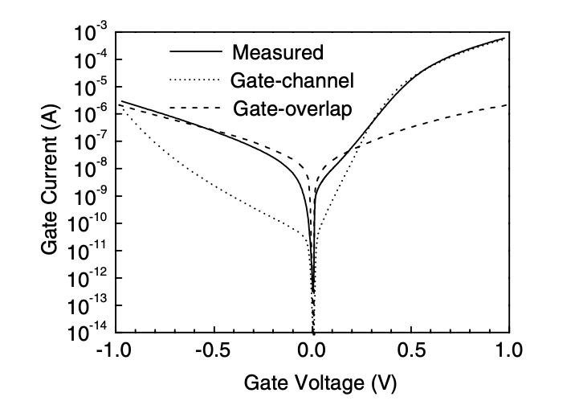
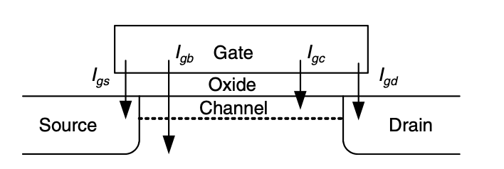
Components of tunneling currents
Figure 14: MOS transistor gate tunneling current components – Gate current measured for an n+ Si/SiO2/p Si MOS capacitor with an n+ source, solid line representing W/L = 562/62 lm and tox = 1.6 nm. The computed gate-overlap and gate-channel components are displayed by the dashed and dotted lines, respectively. Although the overlap area is substantially lower than the channel area, the overlap current component is dominating at low positive and negative gate voltages (depletion–accumulation). [1]

Slide 38
Current Distribution in MOSFET Channels
Gate Current Partitioning: In inversion, the gate current (Igc) splits between the source and drain. The partition ratios (Igcs/Igc and Igcd/Igc) are dependent on the drain–source bias and equalize at zero bias. Experimental verification of these ratios is challenging, emphasizing the complexity of measuring current partitioning.
Position-Dependent Tunneling Current Density: In MOS transistors, the drain-source voltage induces a position-dependent tunneling current density. The total gate current (Ig) integrates the current density (Jg) over the channel, with the effective width (W) and length (L) being crucial. Increasing the drain–source voltage redirects more current to the source, impacting the overall gate current distribution.
Polysilicon Gate Depletion: Highly doped polysilicon gates undergo depletion, deviating from ideal conductors and forming a thin layer that causes a voltage drop. This influences the oxide voltage in tunneling current calculations. Considering polysilicon depletion is crucial for precise modeling, especially in situations requiring accurate device parameter extraction, as seen in C–V measurements for thin-oxide MOSFETs.

Slide 39
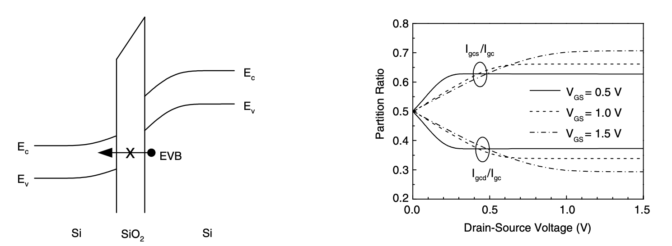
Current Distribution in MOSFET Channels
Figure 15: Diagrammatic band diagram illustrating the need for receiving states inside the semiconductor's energy gap in order to enable EVB tunneling for low voltages across the oxide. For varying gate-source voltages, the channel tunneling current partition ratio as a function of drain voltage [1]

Slide 40
Semiconductor Gate Layer Depletion
Polysilicon Gates: Highly doped polysilicon gates, which form a thin depletion layer, deviate from ideal conductors. The finite thickness of the depletion layer causes a charge distribution that influences the oxide voltage in tunneling current calculations. An accurate estimation of the voltage drop, considering polysilicon gate depletion, uses solutions to the Poisson equation for an “effective” gate voltage.
Position-Dependent Tunneling Current: The tunneling current in MOS transistors is position-dependent and influenced by the drain-source voltage. This current integrates into the total gate current, reflecting spatial variations impacted by the polysilicon gate and depletion effects. Understanding these variations is crucial for optimizing transistor performance.
Quantization Effects: Similar to bulk layers, quantization effects are observed in the polysilicon depletion layer. These effects impact the calculation and modeling of the gate tunneling current. Investigating these effects is crucial for understanding the behavior of polysilicon gates in MOS devices and refining models for accurate simulations and predictions.

Slide 41
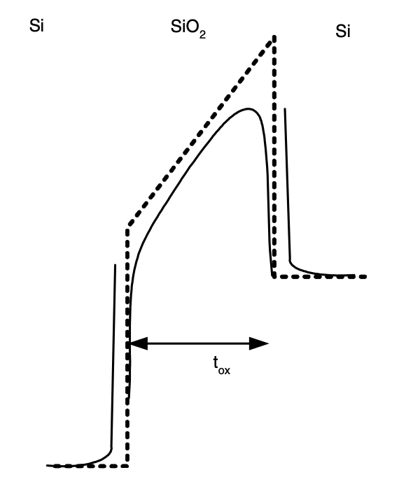
Potential Barrier Lowering Through Image Forces
Figure 16: Potential barrier at the Si–SiO2 interface without image forces (dashed line) and with image forces (solid line) [1]

Slide 42
Potential Barrier Lowering Through Image Forces
Potential Barrier Lowering: The lowering of the potential barrier in MOS structures caused by image forces is often neglected in the calculation of the tunneling current. This argument was given by Weinberg in 1982, stating that for large barriers (like in Si-SiO2), the image-force lowering of the barrier is very small. This was supported by experimental evidence at the time.
Thin Oxides Consideration: For very thin oxides, the barrier lowering might have a significant impact on the calculation of the tunneling current. An ‘effective’ trapezoidal barrier, lowered with respect to the ideal one, has been proposed to account for image force effects.
Recent Findings: Recent results indicate that the tunneling current dependence on the field would not be modeled correctly by such method. This suggests that more research is needed to accurately model the effects of potential barrier lowering on tunneling current in MOS structures with very thin oxides.

Slide 43
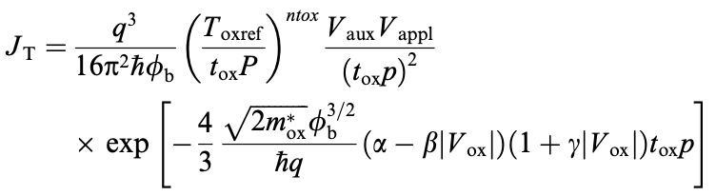
Compact MOS Models: Understanding and Analyzing Gate Current
BSIM4
Model Overview: The Berkeley Short-channel IGFET Model (BSIM), widely used for circuit simulation, includes gate tunneling current starting from version 4.0.0. The BSIM4 gate current model is based on the semi-empirical model of Lee and Hu, with a unified expression for various tunneling current components and mechanisms:
Model Expression: The model uses a common expression for all the tunneling current components and mechanisms. It takes into account various factors such as the tunneling mechanism, the region of operation, and the current component. The model also provides the current densities and the currents.
Notes:
where Toxref is a reference oxide thickness at which the parameters are extracted, ntox is a fitting parameter, Vappl is the applied voltage (which has a different meaning depending on the current component), and the function Vaux and the parameters a, b, c and p depend on the tunnel- ing mechanism (ECB, EVB or HVB), the region of opera- tion (inversion, accumulation or depletion) and the current component (Igb, Igc, Igs or Igd). Table 2 shows the parame- ter values, as well as the definition of the auxiliary function Vaux and the applied voltage Vappl, for each operating re- gion and current component.

Slide 44
Compact MOS Models: Understanding and Analyzing Gate Current
BSIM4
Model Considerations: The BSIM4 model partitions the gate-channel current into components. It also takes into account the depletion in the polysilicon region and ensures a smooth transition from the triode region to the saturation region.
Philips MOS Model 11
Model Overview: The Philips MOS Model 11, featuring an explicit surface potential formulation, deviates from threshold voltage-based models, considering tunneling current negligible and providing tunneling probabilities based on parameters like oxide voltage and inversion layer charge.
a
Notes:
where Toxref is a reference oxide thickness at which the parameters are extracted, ntox is a fitting parameter, Vappl is the applied voltage (which has a different meaning depending on the current component), and the function Vaux and the parameters a, b, c and p depend on the tunnel- ing mechanism (ECB, EVB or HVB), the region of opera- tion (inversion, accumulation or depletion) and the current component (Igb, Igc, Igs or Igd). Table 2 shows the parame- ter values, as well as the definition of the auxiliary function Vaux and the applied voltage Vappl, for each operating re- gion and current component.

Slide 45
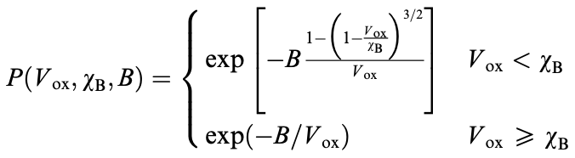
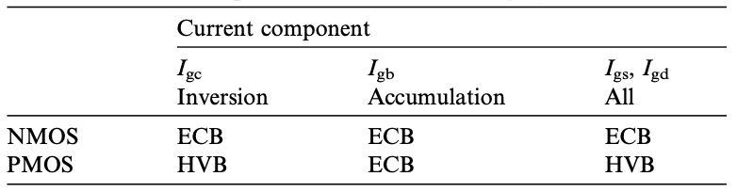
Compact MOS Models: Understanding and Analyzing Gate Current
Philips MOS Model 11
The tunneling probability for each tunneling component and operational zone is provided by:
Table 3: MOS Model 11's dominant current components [1]
Notes:
where Vox, vB, and B depend on the tunneling mechanism and region of operation. The expression for Vox > vB corre- sponds to Fowler–Nordheim tunneling (1), and the expres- sion for Vox < vB is essentially the WKB direct tunneling probability with a triangular barrier for tunneling from a single energy level.

Slide 46
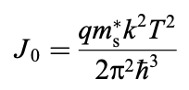
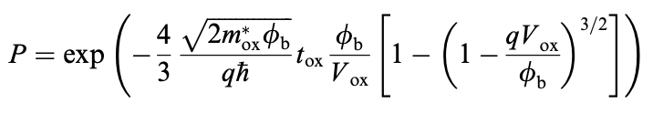
Compact MOS Models: Understanding and Analyzing Gate Current
SP model
Model Overview: The SP model is a surface potential-based compact MOS model. Its gate current model is based on equation (3). The tunneling probability and the supply function are assumed to be independent of the energy, leading to a simplified expression for the tunneling current density:
Model Considerations: The SP model provides an approximate closed-form expression for the gate-channel current by linearizing the supply function and the tunneling probability exponent. The overlap currents are also modeled in SP, and the gate-channel current partition is given by equations.
Notes:
The tunneling probability is derived using the WKB approximation (9), assuming a parabolic dispersion rela- tion in the oxide as in (10) and a triangular potential bar- rier, which results in

Slide 47
Compact MOS Models: Understanding and Analyzing Gate Current
HiSIM
Model Overview: The Hiroshima University STARC IGFET Model (HiSIM) is a compact model based on the drift-diffusion approximation for the drain current. It analytically describes all the device characteristics by the surface potential at the source and drain sides of the MOSFET’s channel.
Model Expression: The gate current model in HiSIM considers only ECB tunneling and is based on band-to-band tunneling theory. It uses an equation that involves parameters such as the energy gap of the bulk semiconductor, the threshold voltage shift due to short-channel effects, and model parameters GLEAK1, GLEAK2, and GLEAK3.
Model Considerations: The gate current partition in HiSIM is based on equations (32) and (33). The tunneling current density is assumed to vary linearly with the position along the channel, allowing for analytical expressions to be obtained for the drain and source components of the gate current.
Notes:
The tunneling probability is derived using the WKB approximation (9), assuming a parabolic dispersion rela- tion in the oxide as in (10) and a triangular potential bar- rier, which results in

Slide 48
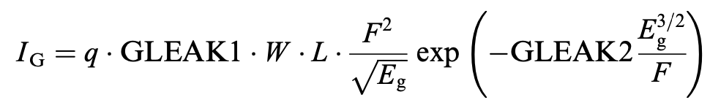
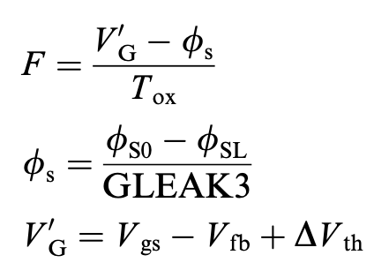
Compact MOS Models: Understanding and Analyzing Gate Current
HiSIM
where,
and, DVth is the threshold voltage shift with respect
to the long-channel Vt caused by short-channel effects,
and Eg is the bulk semiconductor's energy gap. The
model parameters are GLEAK1, GLEAK2, and GLEAK3.

Slide 49
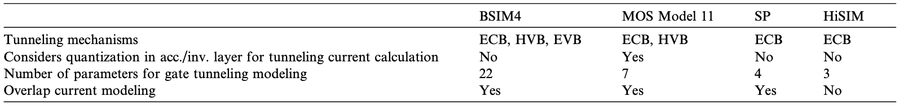
Compact MOS Models: Understanding and Analyzing Gate Current
Table 4: Comparison of gate current compact models [1]

Slide 50
Consequences of Gate Tunneling Current on Device Performance
Digital and analog circuit performance
Demonstrating MOS devices with a 1.5 nm gate oxide thickness in 1994 revealed high gate tunneling current density. Despite heat removal and reliability considerations, high-performance applications can tolerate gate current densities up to 1000 A/cm² (oxide thicknesses of 1–1.5 nm).
For applications such as memory, low-power, and analog circuits, where low gate currents or large-geometry devices are crucial, the minimum gate oxide thickness might need to be in the range of 1.8–2.6 nm.
Gate tunneling current affects various circuit elements, including sample-and-hold cells and CMOS logic, causing issues like increased static power dissipation and voltage swing deviations. This impact extends to MOS RF and analog circuits, influencing maximum operating frequency, power and current gain, input impedance, and device matching, demanding further investigation.

Slide 51
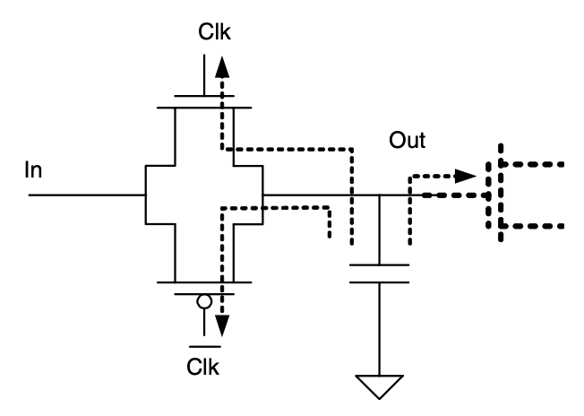
Consequences of Gate Tunneling Current on Device Performance
Figure 17: CMOS sample and hold circuit, illustrating potential gate current leakage paths [1]

Slide 52
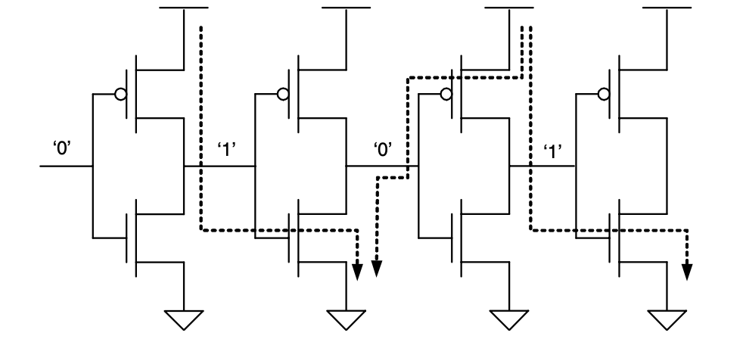
Consequences of Gate Tunneling Current on Device Performance
Figure 18: CMOS inverter chain illustrating the DC current flow between stages brought on by the gate tunneling current. [1]

Slide 53
Consequences of Gate Tunneling Current on Device Performance
Noise
Noise in electronic circuits is a critical concern in digital, analog, and RF applications, impacting bit errors in logic circuits and setting the lower limit of the dynamic range in analog and RF systems.
MOS devices with large gate tunneling currents introduce additional noise sources, including shot noise with a frequency-independent spectral density and low-frequency noise with an approximate 1/f dependence.
The low-frequency noise in gate current is attributed to trap-related mechanisms, with varying explanations such as trap-assisted tunneling or local fluctuations of tunneling probability caused by fluctuating traps. The implications of enhanced noise due to gate current are more pronounced at relatively low frequencies and can affect drain current noise as well.

Slide 54
Conclusion
The effect of the gate current on the functionality of the CMOS inverter has been investigated. It has been found that the output low-level voltage increases for gate thickness thinner than 2nm. This increase worsens the noise margin and can result in faulty operation for the CMOS inverter.
The Fowler-Nordheim model for tunneling was demonstrated to be inadequate for capturing effects in modern MOSFET technology, such as direct tunneling and valence band tunneling, emphasizing the need for more advanced models. Industry-standard compact MOS models were outlined, revealing their modeling approaches and limitations, including simplifications and non-physical aspects leading to a high number of parameters and potential inaccuracies.
The discussion on the impact of tunneling current on circuit performance highlighted challenges for device, circuit, and system designers. Despite the effects on various applications, it was noted that this should not hinder the continued down-scaling of MOS devices, posing new challenges instead.

Slide 55
Conclusion
The review emphasized the significance of noise in analog and RF circuits, underlining its role as a key concern in the design of digital, analog, and RF applications.
The discussion on additional noise sources caused by gate current, both at high and low frequencies, highlighted the challenges associated with the characterization and modeling of noise characteristics in MOS devices with substantial gate tunneling currents.
The conclusion stressed the importance of addressing the impact of tunneling current on circuit performance, acknowledging its influence on diverse applications. It called for attention to studying these issues and developing compact models suitable for use in circuit simulators to advance the understanding and mitigation of these challenges.

Slide 56
References
Juan C. Ranuarez, M.J. Deen, Chih-Hung Chen; A review of gate tunneling current in MOS devices; 2006
Xiaoyong Yang, Deobrat Singh and Rajeev Ahuja; Tunneling in thin MOS structures; 1974
M. Abdelgawad EL-Sayed and M.Atef; Study of tunneling current through ultra-thin gate oxide MOSFET and its effect on CMOS circuits; 2005
Fabio Sacconi, Michael Povolotskyi, Aldo Di Carlo, Paolo Lugli, Martin St€adele; Full-band approaches to the electronic properties of nanometer-scale MOS structures; 2003
Lezlinger M, Snow EH; Fowler–Nordheim tunneling into thermally grown SiO2; 1969
Weinberg ZA; On tunneling in metal–oxide–silicon structures; 1982
Maserjian J; Tunneling in thin MOS structures; 1974
Chang L, Yang KJ, Yeo Y-C, Polishchuk I, King T-J, Hu C; Direct- tunneling gate leakage current in double-gate and ultrathin body MOSFETs; 2002
Govoreanu B, Blomme P, Henson K, Van Houdt J, De Meyer K. An effective model for analyzing tunneling gate leakage currents through ultrathin oxides and high-k gate stacks from Si inversion layers; 2004

